Slide 1
Cyber Security
Technology and process that is designed to protect networks and devices from attack, damage or unauthorized access.
Advantages
Protects your business
Increase productivity
Inspire customer confidence
Stops your website from crashing
Protection for your customers or clients

Slide 2
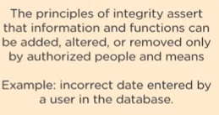
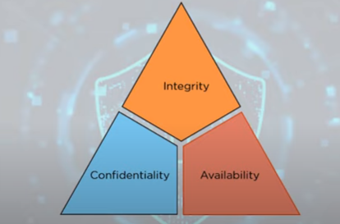


Why Cyber Security
Industry Standards for computer Security

Slide 3
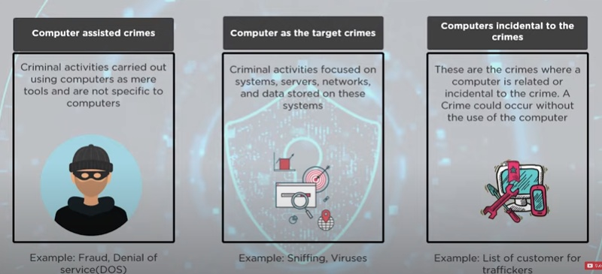
Types of cyber crime

Slide 4
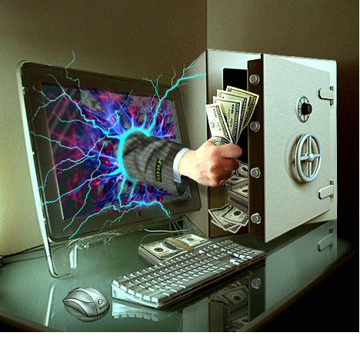
1.2 DEFINING CYBER CRIME
Crime committed using a computer and the internet to steal data or information.

Slide 5
further
Cybercrime refers to the act of performing a criminal act using cyberspace as communication vehicle.
Two types of attacks are common:
Techno- crime : Active attack
Techno Crime is the term used by law enforcement agencies to denote criminal activity which uses (computer) technology, not as a tool to commit the crime, but as the subject of the crime itself. Techno Crime is usually pre-meditated and results in the deletion, corruption, alteration, theft or copying of data on an organization's systems.
Techno Criminals will usually probe their prey system for weaknesses and will almost always leave an electronic 'calling card' to ensure that their pseudonym identity is known.
Techno – vandalism: Passive attack
Techno Vandalism is a term used to describe a hacker or cracker who breaks into a computer system with the sole intent of defacing and or destroying its contents.
Techno Vandals can deploy 'sniffers' on the Internet to locate soft (insecure) targets and then execute a range of commands using a variety of protocols towards a range of ports. If this sounds complex - it is! The best weapon against such attacks is a firewall which will hide and disguise your organization's presence on the Internet.

Slide 6
Hackers, Crackers and Phreakers
A hacker is a person with strong interest in computers who enjoys learning and experimenting with them. Hackers are usually very talented, smart people who understand computers better than others.
Brute force hacking
It is a technique used to find passwords or encryption keys. Brute force hacking involves trying every possible combination of letters, numbers, etc until the code is broken.

Slide 7
Cracker
A cracker is a person who breaks into computers. Crackers should not be confused with hackers. The term cracker is usually connected to computer criminals.
Cracking
It is the act of breaking into computers. Cracking is popular, growing subject on the internet. Many sites are devoted to supplying crackers with programs that allow them to crack computers.
Phreaking
This is the notorious art of breaking into communication system. Phreaking sites are popular among crackers and other criminals.

Slide 8
There are 3 types of modern hackers
Black Hats: Criminal Hackers.
Possess desire to destruction
Hack for personal monetary gains : Stealing credit card information, transferring money from various bank accounts to their own account, extort money from corporate giant by threatening.
White Hats: Ethical Hackers.
Network Security Specialist.
Grey Hats: Deals in both of the above (jack of all trades, master of none).

Slide 9
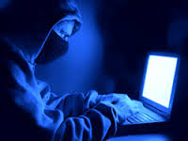
1.4 Who are Cybercriminals?
Are those who conduct acts such as:
Child pornography
Credit card fraud
Cyberstalking
Defaming others online
Gaining unauthorized access to computer systems
Ignoring copyrights
Software licensing and trademark protection
Overriding encryption to make illegal copies
Software piracy
Stealing another’s identity to perform criminal acts

Slide 10

Categorization of Cybercriminals
Type 1: Cybercriminals- hungry for recognition
Hobby hackers
A person who enjoys exploring the limits of what is possible, in a spirit of playful cleverness. May modify hardware/ software
IT professional(social engineering):
Ethical hacker
Politically motivated hackers :
promotes the objectives of individuals, groups or nations supporting a variety of causes such as : Anti globalization, transnational conflicts and protest
Terrorist organizations
Cyberterrorism
Use the internet attacks in terrorist activity
Large scale disruption of computer networks , personal computers attached to internet via viruses

Slide 11
Type 2: Cybercriminals- not interested in recognition
Psychological perverts
deviates from normal behavior
Financially motivated hackers
Make money from cyber attacks
Bots-for-hire : fraud through phishing, information theft, spam and extortion
State-sponsored hacking
Hacktivists
Extremely professional groups working for governments
Have ability to worm into the networks of the media, major corporations, defense departments

Slide 12
Type 3: Cybercriminals- the insiders
Disgruntled or former employees seeking revenge
Competing companies using employees to gain economic advantage through damage and/ or theft.

Slide 13
1.5 Classification of cybercrimes
Cybercrime against an individual
Cybercrime against property
Cybercrime against organization
Cybercrime against Society
Crimes emanating from Usenet newsgroup

Slide 14
1. Cybercrime against an individual
Electronic mail spoofing and other online frauds
Phishing, spear phishing
spamming
Cyber Defamation
Cyberstalking and harassment
Computer sabotage
Pornographic offenses
password sniffing

Slide 15
Spoofing
Types of spoofing
Spoofing, as it pertains to cyber security, is when someone or something pretends to be something else in an attempt to gain our confidence, get access to our systems, steal data, steal money, or spread malware.”
Email spoofing
Website spoofing
Text message spoofing
Caller ID spoofing:
GPS spoofing

Slide 16
Man-in-the-middle (MitM) attack:
You like that free Wi-Fi at your local coffee shop? Have you considered what would happen if a cybercriminal hacked the Wi-Fi or created another fraudulent Wi-Fi network in the same location? In either case, you have a perfect setup for a man-in-the-middle attack, so named because cybercriminals are able to intercept web traffic between two parties. The spoof comes into play when the criminals alter the communication between the parties to reroute funds or solicit sensitive personal information like credit card numbers or logins.

Slide 17
2.Cybercrime against property
Credit card frauds
Intellectual property( IP) crimes
Internet time theft

Slide 18
3.Cybercrime against organization
Unauthorized accessing of computer
Password sniffing
Denial-of-service attacks
Virus attack/dissemination of viruses
E-Mail bombing/mail bombs
Salami attack/ Salami technique
Logic bomb
Trojan Horse
Data diddling
Industrial spying/ industrial espionage
Computer network intrusions
Software piracy

Slide 19
4.Cybercrime against Society
Forgery
Cyberterrorism
Web jacking

Slide 20
5.Crimes emanating from Usenet newsgroup
Usenet groups may carry very offensive, harmful, inaccurate material
Postings that have been mislabeled or are deceptive in another way
Hence service at your own risk

Slide 21
History of Usenet groups
In 1979 it was developed by two graduate students
from Duke University in North Carolina (UNC) as a network that allowed users to exchange quantities of information too large for mailboxes
Usenet was designed to facilitate textual exchanges between scholars.
Slowly, the network structure adapted to allow the exchange of larger files such as videos or images.

Slide 22
Usenet groups as a “safe” place?
Usenet newsgroups constitute one of the largest source of child pornography available in cyberspace
This source useful for observing other types of criminal or particular activities: online interaction between pedophiles, adult pornographers and writers of pornographic stories.
Usenet for sharing illegal content

Slide 23
Cyber defamation
The tort of cyber defamation is considered to be the act of defaming, insulting, offending or otherwise causing harm through false statements pertaining to an individual in cyberspace.
Example: someone publishes defamatory matter about someone on a website or sends an E-mail containing defamatory information to all friends of that person.

Slide 24
It may amount to defamation when-
If imputation to a deceased person would harm the reputation of that person, and is intended to be hurtful to the feelings of his family or other near relatives
An imputation is made concerning a company or an association or collection of people as such.
An imputation in the form of an alternative or expressed ironically
An imputation that directly or indirectly, in the estimation of others, lowers the moral or intellectual character of that person, or lowers the character of that person in respect of his caste or of his calling, or lowers the credit of that person.

Slide 25
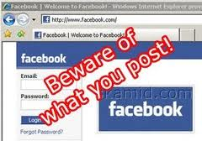
Types of defamation
Libel : written defamation
Slander: oral defamation
The plaintiff must have to show that the defamatory statements were unlawful and would indeed injure the person’s or organization’s reputation.
When failed to prove, the person who made the allegations may still be held responsible for defamation.

Slide 26
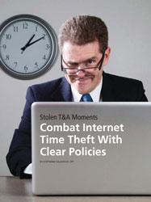
Internet Time Theft
Occurs when an unauthorized person uses
the Internet hours paid for by another person
Comes under hacking
The person get access to someone else’s ISP user ID and password, either by hacking or by gaining access to it by illegal means
And uses the internet without the other person’s knowledge
This theft can be identified when Internet time is recharged often, despite infrequent usage.
This comes under “identity theft”

Slide 27
Salami attack/ salami technique
Are used for committing financial crimes.
The alterations made are so insignificant that in a single case it would go completely unnoticed.
Example: a bank employee inserts a program, into the bank’s server, that deduces a small amount from the account of every customer every month,
The unauthorized debit goes unnoticed by the customers, but the employee will make a sizable amount every month.

Slide 28
Spamming
People who create electronic spam : spammers
Spam is abuse of electronic messaging systems to send unsolicited bulk messages indiscriminately
Spamming may be
E-Mail Spam
Instant messaging spam
Usenet group spam
Web search engine spam
Spam in blogs, wiki spam
Online classified ads spam
Mobile phone messaging spam
Internet forum spam
Junk fax spam
Social networking spam
……..

Slide 29

Data diddling
Data diddling involves changing data input in a computer.
In other words, information is changed from the way it should be entered by a person typing in the data.
Usually, a virus that changes data or a programmer of the database or application has pre-programmed it to be changed.
For example, a person entering accounting may change data to show their account, or that or a friend or family member, is paid in full. By changing or failing to enter the information, they are able to steal from the company.

Slide 30
Forgery
The act of forging something, especially the unlawful act of counterfeiting a document or object for the purposes of fraud or deception.
Something that has been forged, especially a document that has been copied or remade to look like the original.
Counterfeit currency notes, postage, revenue stamps, marksheets, etc., can be forged using sophisticated computers, printers and scanners.

Slide 31

Web jacking
This term is derived from the term hi jacking.
In these kinds of offences the hacker gains access and control over the web site of another.
He may even change the information on the site.
The first stage of this crime involves “password sniffing”.
The actual owner of the website does not have any more control over what appears on that website
This may be done for fulfilling political objectives or for money

Slide 32
Hacking
Every act committed toward breaking into a computer and/ or network is hacking.
Purpose
Greed
Power
Publicity
Revenge
Adventure
Desire to access forbidden information
Destructive mindset

Slide 33
History of hacking
hacking is any technical effort to manipulate the normal behavior of network connections and connected systems.
A hacker is any person engaged in hacking.
The term "hacking" historically referred to constructive, clever technical work that was not necessarily related to computer systems.
In the 1950s and 1960s the term and concept of hacking was popularized for first time.
the so-called "hacks" perpetrated by these hackers were intended to be harmless technical experiments and fun learning activities.
As computer networking and the Internet exploded in popularity, data networks became by far the most common target of hackers and hacking.

Slide 34
Hacking vs. Cracking
Malicious attacks on computer networks are officially known as cracking ,
while hacking truly applies only to activities having good intentions.
Most non-technical people fail to make this distinction, however.
Outside of academia, its extremely common to see the term "hack" misused and be applied to cracks as well.

Slide 35
Hackers, crackers, phreakers
General term
Breaks computers system
Targeting mobile phones

Slide 36
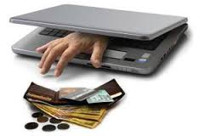
Online frauds
Fraud that is committed using the internet is “online fraud.” Online fraud can involve financial fraud and identity theft.
Online fraud comes in many forms.
viruses that attack computers with the goal of retrieving personal information, to email schemes that attracts victims into wiring money to fraudulent sources,
“phishing” emails that seems to be from official entities (such as banks or the Internal Revenue Service) that solicit personal information from victims to be used to commit identity theft,
to fraud on online auction sites where perpetrators sell fictional goods.
E-Mail spoofing to make the user to enter the personal information : financial fraud
Illegal intrusion: log-in to a computer illegally by having previously obtained actual password. Creates a new identity fooling the computer that the hacker is the genuine operator. Hacker commits innumerable number of frauds.

Slide 37
DoS & DDoS attack
-Denial of service- intended users
- flood b/w of victim’s network
- ways to DoS
-DDoS

Slide 38
Pornographic offenses: Child pornography
Means any visual depiction, including but not limited to the following:
Any photograph that can be considered obscene and/ or unsuitable for the age of child viewer.
Film ,video, picture;
Obscene Computer generated image or picture

Slide 39
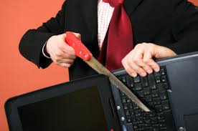
Computer sabotage
Computer sabotage involves deliberate attacks intended to disable computers or networks for the purpose of disrupting commerce, education and recreation for personal gain, committing espionage, or facilitating criminal conspiracies.
Through viruses, worms, logic bombs
E.g: Chernobyl virus
The Chernobyl virus is a computer virus with a potentially devastating payload that destroys all computer data when an infected file is executed.,

Slide 40
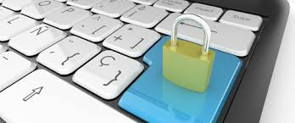
Computer network intrusions
An intrusion to computer network from any where in the world and steal data, plant viruses, create backdoors, insert trojan horse or change passwords and user names.
An intrusion detection system (IDS) inspects all inbound and outbound network activity and identifies suspicious patterns that may indicate a network or system attack from someone attempting to break into or compromise a system.
The practice of strong password

Slide 41
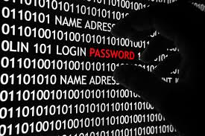
Password sniffing
Password sniffers are programs that monitor and record the name and password of network users as they login, threaten security at a site.
through sniffers installed, anyone can impersonate an authorized user and login to access restricted documents.
Laws are not yet set up to adequately
prosecute a person for impersonating
another person online.

Slide 42
Password cracking
Process of recovering passwords from data stored or transmitted by computer
Manual cracking
Guessing

Slide 43
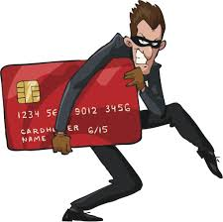
Credit card frauds
Credit card fraud is a wide-ranging term for theft and fraud committed using or involving a payment card, such as a credit card or debit card, as a fraudulent source of funds in a transaction.
The purpose may be to obtain goods without paying, or to obtain unauthorized funds from an account.
Credit card fraud is also an adjunct to identity theft.

Slide 44
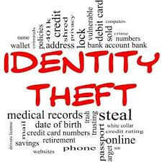
Identity theft
Identity theft is a fraud involving another person’s identity for an illicit purpose.
The criminal uses someone else’s identity for his/ her own illegal purposes.
Phishing and identity theft are related offenses
Examples:
Fraudulently obtaining credit card details
Stealing money from victim’s bank account
Using victim’s credit card number
Establishing accounts with utility companies
Renting an apartment
Filing bankruptcy using the victim’s name

Slide 45
2. Cyber offences: how criminals Plan them
Technology misuse
- target of offence
- means for committing an offence
Misuse of PI
- DOB
- e-mail ID
- Bank account details
- credit card details

Slide 46
Phases involved in planning cybercrime
1. Reconnaissance (information gathering)
2. Scanning and scrutinizing the gathered information (validity of information and identify proneness/sensitivity)
3. Launching an attack (gaining and maintaining the system access)

Slide 47
How Criminal Plan the Attacks
Many methods and tools are used to locate target
Target- Individual/Organization
Types of attacks
- Passive (gain information)
affects confidentiality
- Active (alter information)
affect availability, integrity and authenticity
Can be
- Inside (attempted within security parameter)
- Outside (using internet or remote access)

Slide 48
Passive Attacks
Gathering information
Using Internet searches or by Googling
-Google or Yahoo search
- Surfing online community groups likes Orkut/ Facebook….
- Organization’s website
- Blogs, newsgroups, press releases, etc
- Going through job postings in particular job profiles for technical persons.

Slide 49
List of tools used during passive attacks
Google Earth
Internet Archieve
Professional community
People search
Domain Name confirmation
WHOIS
Nslookup
DNSstuff
Traceroute
Visual Route Trace

Slide 50
Active attacks
Probing network to confirm the information
Involves risk of detection
Provides confirmation to attacker about security measures

Slide 51
2. Scanning and scrutinizing the gathered information
Key step to examine intelligently while gathering information
-Scanning objectives
1. Valid used accounts or groups
2. Network &/or shared resources
3. OS and different applications that are running on the OS.
Port scanning
Network Scanning
Vulnerability scanning.

Slide 52
3. Launching the attack
Usually 90% time is used for first 2 steps and 10% to launch the attack
Attack is launched using following steps
Crack the password
Exploit the privileges
Execute the malicious commands/ applications
Hide the files (if required)
Cover the tracks

Slide 53
ITA 2000
Act of Indian parliament(No 21 of 2000)
17 th October 2000.
UNCITRAL –Model law, 1996
UN - 1997
India – 12th country to enable cyberlaw.

Slide 54
Objectives of ITA 2000
Provides legal recognition to transactions done by EDI and other electronics means of communication or E-commerce transactions.
This act amends existing laws-
IPC 1860, IEA 1872,
Bankers’ book Evidence Act 1891 and RBI Act 1934.

Slide 55
Features of ITA 2000
It provides legal recognition to records in the electronic form.
It provides legal recognition to e-commerce and electronic transactions in India.
It provides legal recognition to digital signature issued and authenticated by the certifying authorities.
It is applicable to cybercrimes and contraventions committed in India and outside India by any person, irrespective of nationality, if the cybercrime is committed in India or involved any computer based in India.
It has appointment of adjudicating officers for holding inquiries under the Act.It elaborates on offences, penalties and breaches.
It has established the Cyber Appellate Tribunal to hear appeals.

